Slide 1
NGS data analysis - MLST -
Birgit Strommenger NRC for staphylococci and enterococci
Division Nosocomial pathogens and antibiotic resistances
Department of Infectious Diseases
Robert Koch-Institute Wernigerode
Freiburg, 12.10.2017

Slide 2
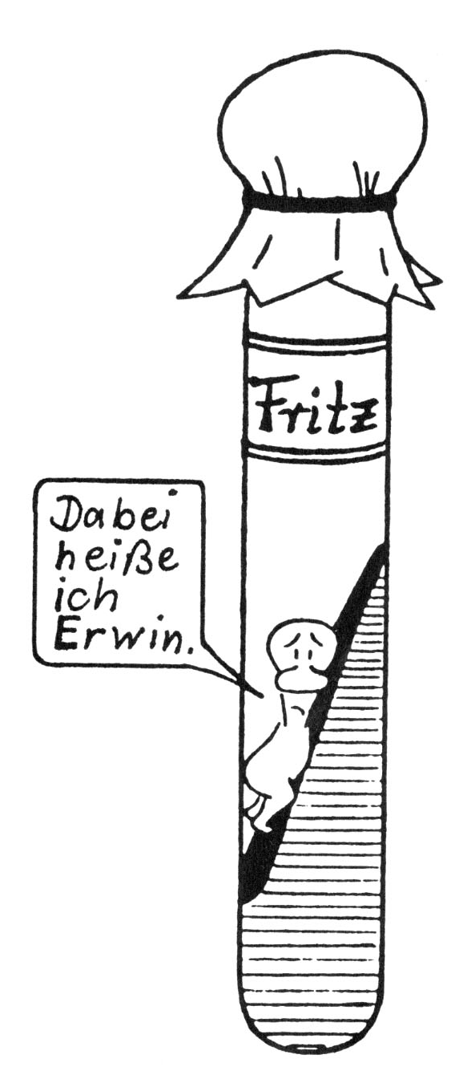
Introduction into MLST and BURST
MLST from NGS data
Hands on using the CGE-website (Center for genomic epidemiology, DTU, Copenhagen)
Experiences and considerations for choosing a tool
Fritz
But I'm still Mike!
http://www.joachim-czichos.de/

Slide 3
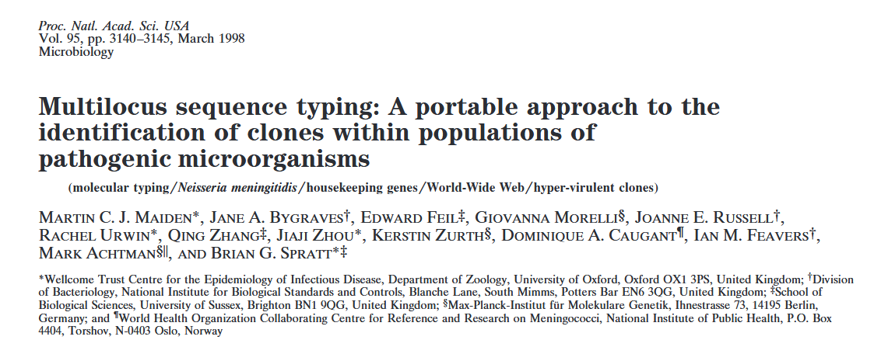

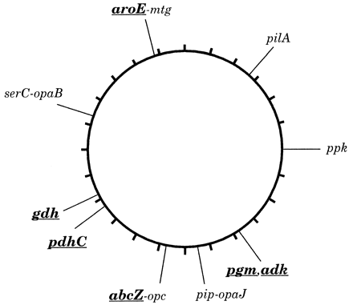
MLST -basis and principle-
*
Established for studies on population structure in epidemiological investigations
Based on allelic variation amongst (mostly) seven housekeeping genes
available for a diversity of bacterial, fungal and eukaryotic pathogens
*betanews.com

Slide 4
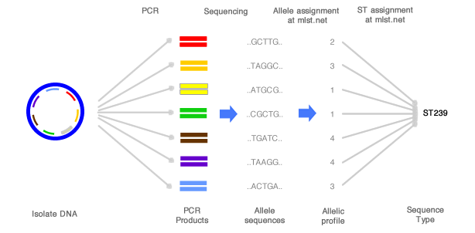
Multilocus sequence typing -principle-
http://beta.mlst.net

Slide 5
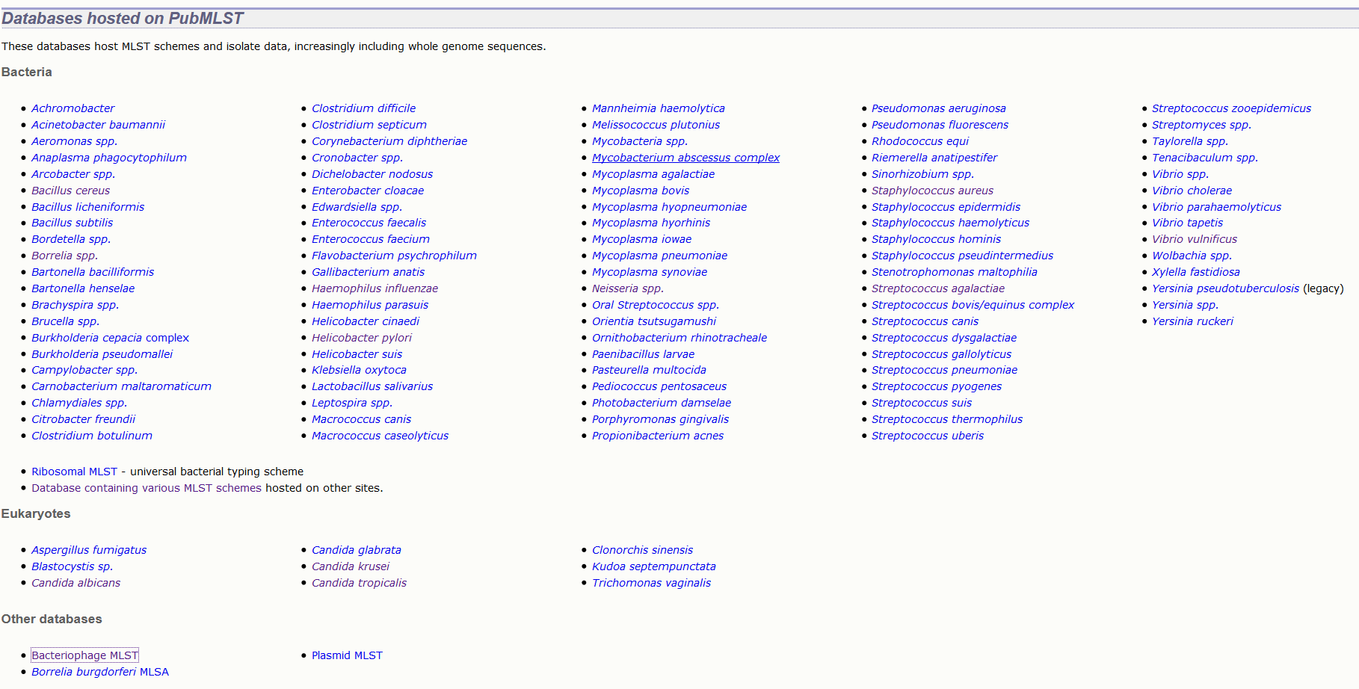

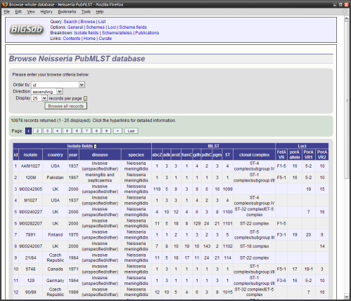
https://pubmlst.org/databases/ The Department of Zoology, University of Oxford, UK , funded by The Wellcome Trust.
www.mlst.net
Imperial College , funded by The Wellcome Trust.

Slide 6
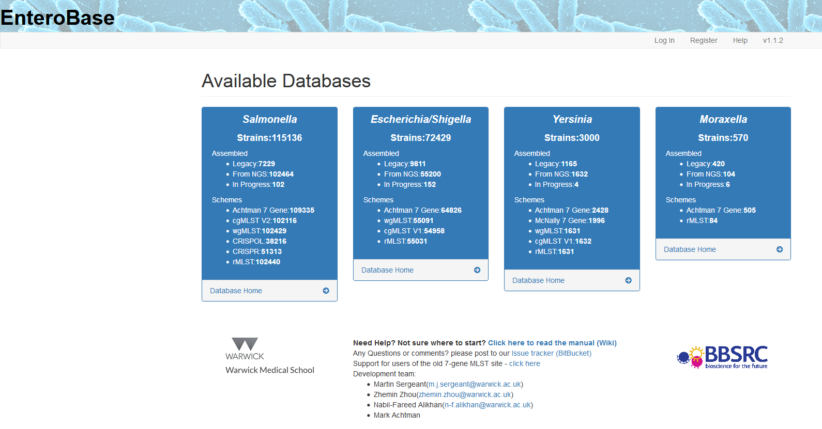
http://enterobase.warwick.ac.uk/

Slide 7
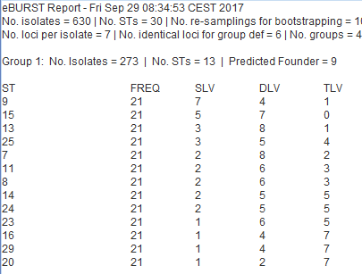

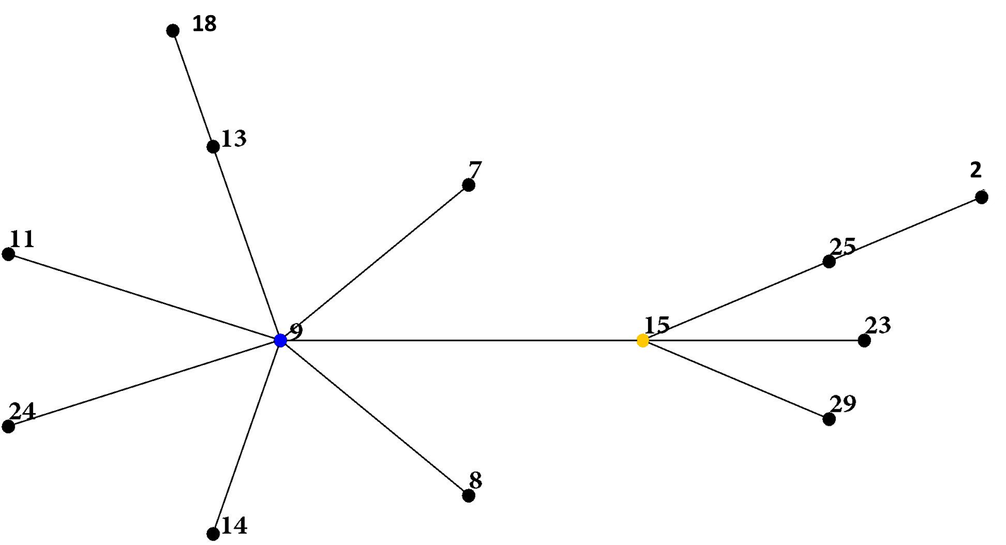
Cluster analysis using (e)BURST -principle-
ST | aroE | gdh | gki | recP | spi | xpt | ddl
1 | 1 | 1 | 1 | 1 | 1 | 1 | 1
6 | 1 | 5 | 2 | 1 | 9 | 3 | 49
7 | 1 | 5 | 4 | 1 | 5 | 1 | 8 | SLV
8 | 1 | 5 | 4 | 5 | 17 | 1 | 8 | SLV
9 | 1 | 5 | 4 | 5 | 5 | 1 | 8 | F
10 | 1 | 5 | 4 | 5 | 9 | 1 | 10
11 | 1 | 5 | 4 | 5 | 10 | 1 | 8 | SLV
12 | 1 | 5 | 4 | 4 | 9 | 3 | 16
13 | 1 | 5 | 4 | 5 | 5 | 27 | 8 | SLV
14 | 1 | 5 | 4 | 5 | 5 | 1 | 14 | SLV
15 | 1 | 5 | 4 | 5 | 5 | 3 | 8 | SLV+SF
16 | 1 | 5 | 4 | 12 | 5 | 27 | 8 | DLV
17 | 1 | 5 | 4 | 11 | 9 | 3 | 47
18 | 1 | 5 | 4 | 11 | 9 | 3 | 16
19 | 1 | 5 | 4 | 18 | 9 | 3 | 16
20 | 1 | 5 | 4 | 1 | 5 | 3 | 3 | DLV2
21 | 1 | 5 | 4 | 11 | 9 | 3 | 4
22 | 1 | 5 | 4 | 11 | 9 | 43 | 52
23 | 1 | 5 | 4 | 5 | 35 | 3 | 8 | SLV2
24 | 1 | 5 | 4 | 5 | 5 | 1 | 24 | SLV
25 | 1 | 5 | 4 | 1 | 5 | 3 | 8 | SLV2
26 | 1 | 5 | 7 | 12 | 26 | 1 | 14
27 | 1 | 5 | 9 | 1 | 14 | 14 | 6
28 | 1 | 5 | 9 | 1 | 9 | 14 | 6
29 | 1 | 5 | 10 | 5 | 5 | 3 | 8 | SLV2
30 | 1 | 5 | 27 | 20 | 1 | 1 | 1
http://eburst.mlst.net/3.asp

Slide 8
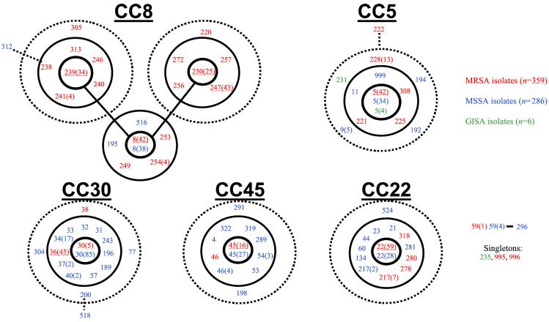
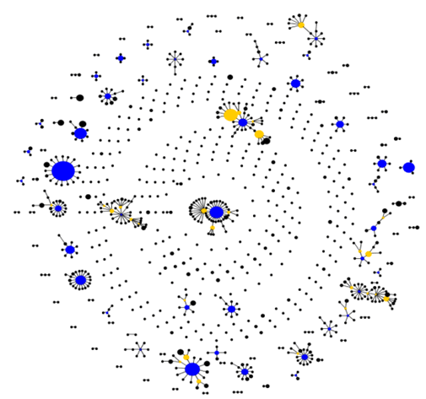
Cluster analysis using (e)BURST -principle-

Slide 9
MLST from NGS data -tools-
Software | Interface | Source | Input | Algorithm
BigsDB | Website | Open source | Contigs | BLASTN
EnteroBase |  |  | Reads | UBLAST/USEARCH
MLST-CGE |  |  | Reads/Contigs | BLASTN
ARIBA | Command line | Open source | Reads | Assembly
MOST |  |  | Reads | Mapping
mlst |  |  | Contigs | BLASTN
MLSTcheck |  |  | Contigs | BLASTN
SRST2 |  |  | Reads | Mapping
stringMLST |  |  | Reads | k-mer
BioNumerics | Graphical user interface (GUI) | Propietary/commercial | Reads/Contigs | k-mer/BLASTN
SeqSphere |  |  | Reads/Contigs | NA
Adapted from: Page et al. 2017

Slide 10
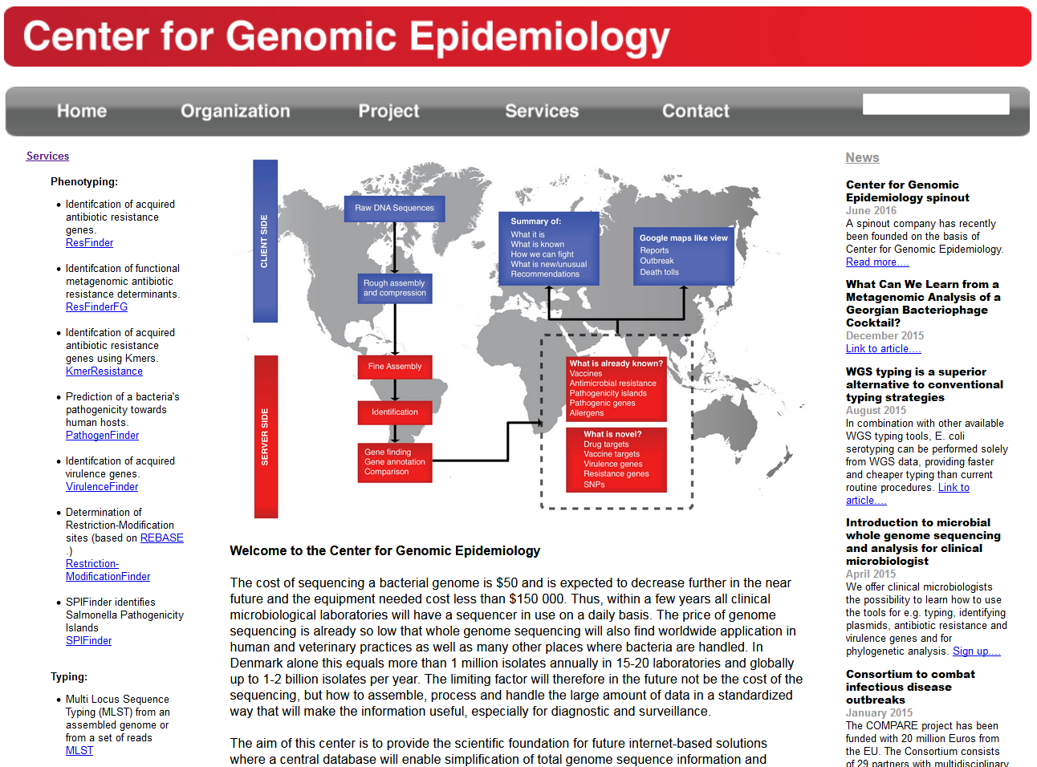
http://www.genomicepidemiology.org/

Slide 11
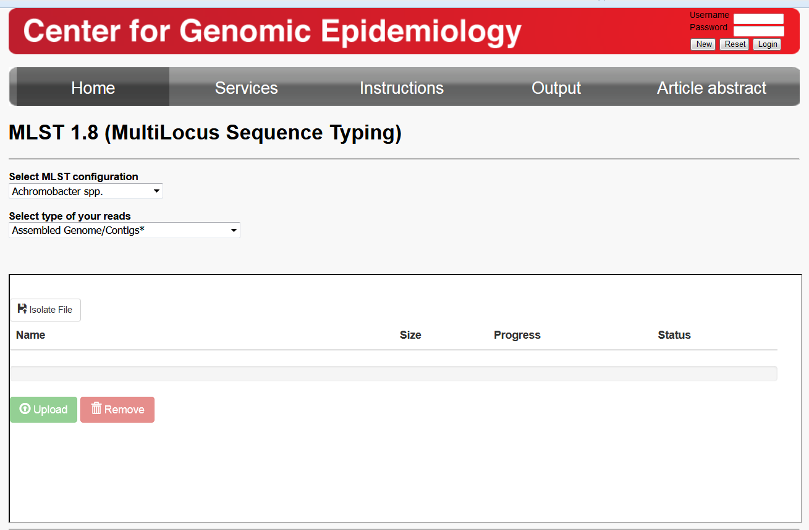
https://cge.cbs.dtu.dk/services/MLST/

Slide 12
Hands on......
Use the following raw data/assembled data: .....
Use your experiences! Please assemble ..... using either SPADES, VELVET or a5 Save contig file (*.fasta) to ......
Go to: https://cge.cbs.dtu.dk/services/MLST/
Choose your MLST scheme (organism)
Choose data type
Upload corresponding files
Use raw data as well as assemblys generated with different assemblers
Compare process and results

Slide 13

......exchange your......
http://firsthandexperiences.co.uk/

Slide 14
Considerations for choosing a MLST tool
High specificity of calling STs
Database availability (timeliness of MLST data, interval of database updates)
Low coverage
Mixed samples
Simple installation and use
Computational resources
Scalability

Slide 15
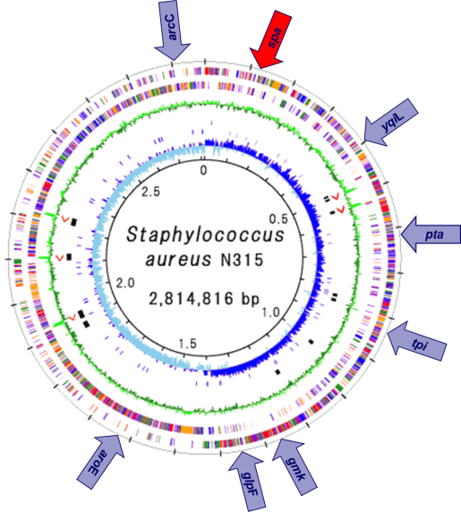
Beyond MLST.....
spa-Typ
MLST (7 loci)
cgMLST (1861 loci)

Slide 16
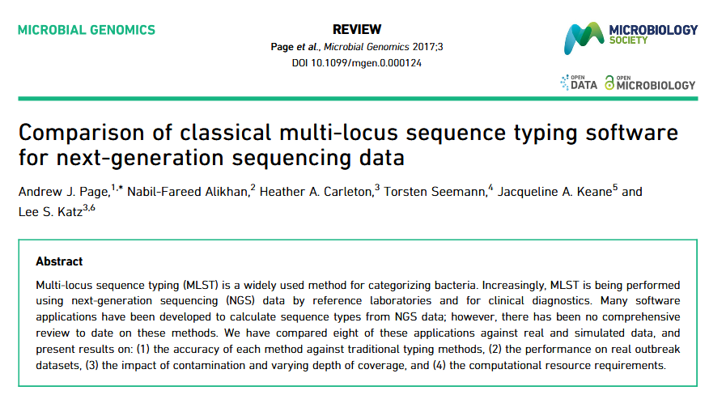
Acknowledgement

Slide 17
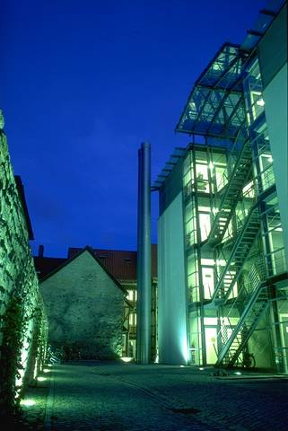

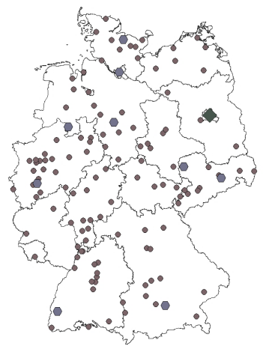
Acknowledgement
FG13 RKI Wernigerode
Jennifer Bender
Stephan Fuchs
Franziska Layer
Mike Henkel
Franziska Erdmann
Guido Werner
RKI Berlin
MF2 Sequencing Service
M1 Bioinformatic Service
NG1
ZV4
Quelle: RKI
Quelle: RKI
All diagnostic laboratories for sending bacterial isolates

Slide 18
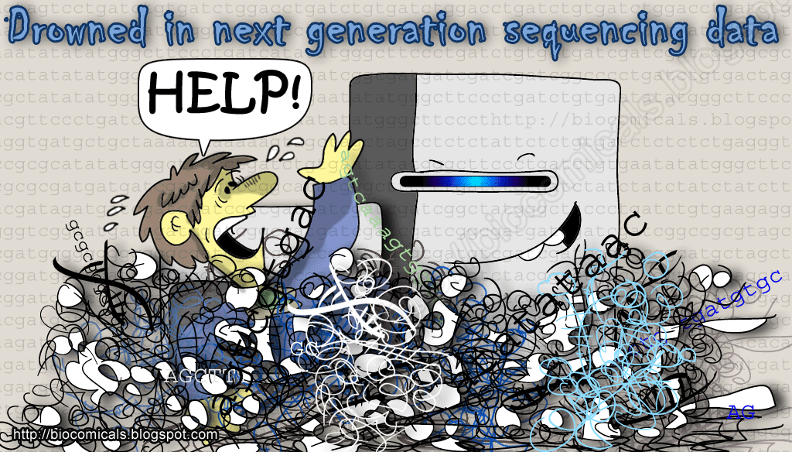
Thank you!

